Slide 1
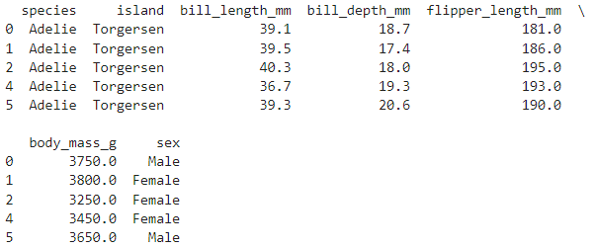


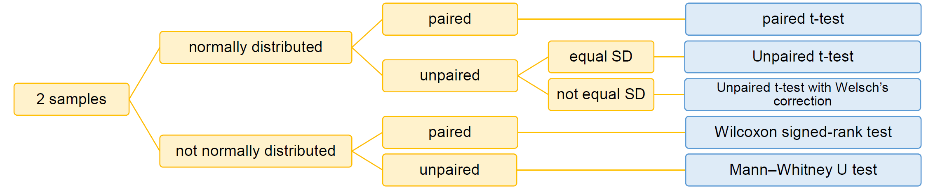
Unpaired t-test: Welch
X: select 2 groups
Y
Dataset: "penguins" from seaborn library
Normality of the data within each group
Can handle unequal variance
Adelie
Chinstrap
https://ebird.org/species/adepen1
https://ebird.org/species/chipen2
https://ilias.unibe.ch/ilias.php?baseClass=ilLinkResourceHandlerGUI&ref_id=3144021&cmd=calldirectlink

Slide 2
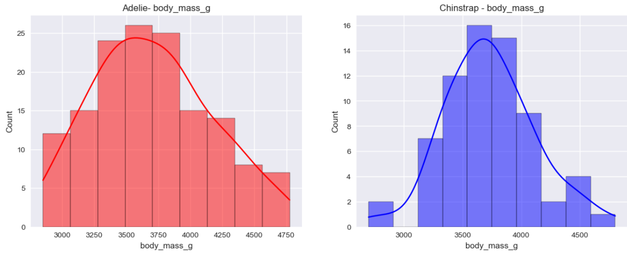
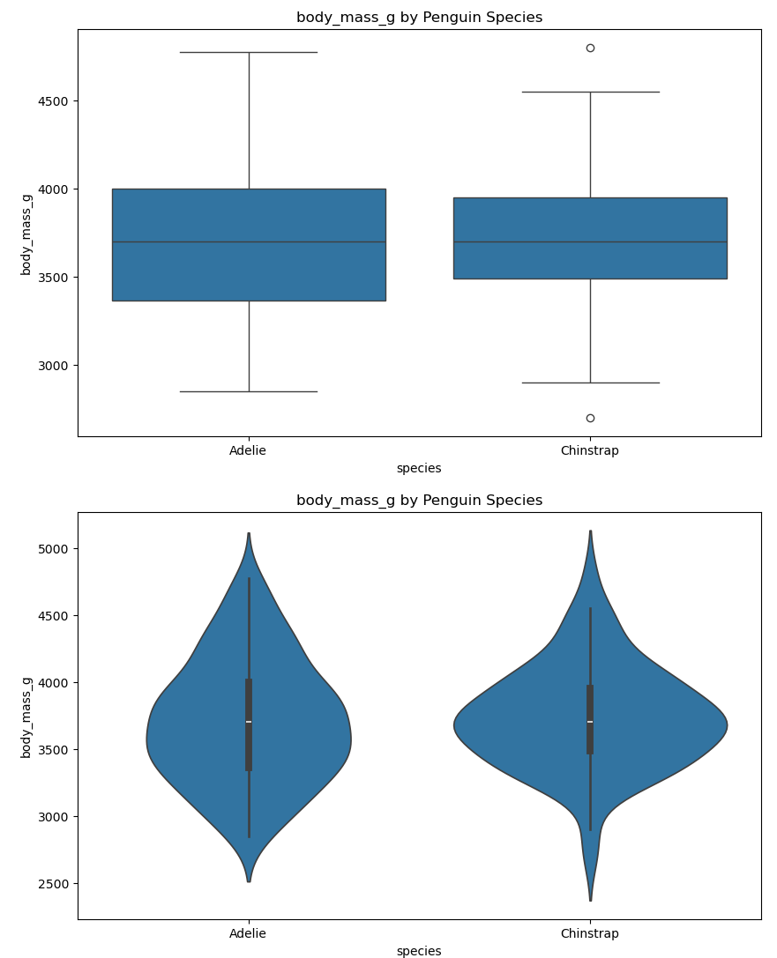
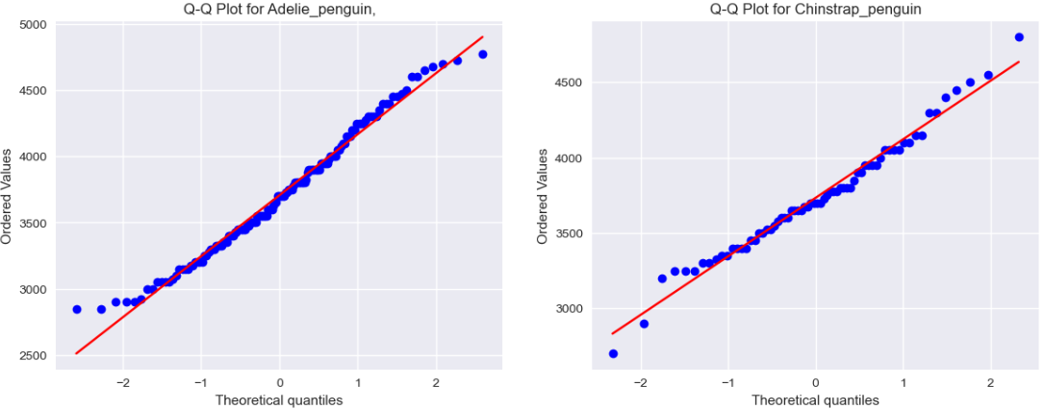

Assumptions controls and results
Normality
Unequal variance
Result
P-value > 0.05 non significant, we can not reject the null hypothesis: there is no difference of weight between Adelie and Chinstrap !

